Slide 1

Netflix Data Analysis Project
Submitted by : Arya Nandini
AICTE Internship ID : INTERNSHIP_17546440516895be538720f

Slide 2

Problem Statement :
Netflix has grown into one of the world’s leading streaming platforms, offering a constantly expanding mix of original shows and licensed titles. But as competition rises from services like Amazon Prime Video, Disney+, and various regional OTT platforms, Netflix needs to take a closer look at its content library to understand what’s working, what’s missing, and where new opportunities lie.
This project focuses on “Content Trends Analysis for Strategic Recommendations.” The goal is to explore how Netflix’s content lineup — including the balance between movies and TV shows, popular genres, and contributions from different countries — has changed over the years. By analyzing these trends, we aim to highlight key audience preferences, uncover strong-performing genres, and provide insights that can guide Netflix’s global content strategy.

Slide 3
Project Description :
This project focuses on analyzing how Netflix’s content library has evolved over time. It examines the growth and distribution of Movies and TV Shows, tracks how the popularity of different genres has shifted, and compares contributions from various countries to understand the platform’s global diversity.
The aim is to uncover patterns and trends that reveal what kind of content performs best and which areas have potential for growth. Based on these insights, the study will offer strategic recommendations to help Netflix strengthen its future content acquisition, production planning, and regional expansion strategies.
Significance of the Study
This analysis plays an important role in understanding how Netflix’s content choices have evolved and how audiences are engaging with them. By identifying which genres are most popular and which regions are underrepresented, the study provides practical insights that can help Netflix make smarter, data-driven business decisions.
These findings can be especially useful for:
Improving content strategy: Balancing global appeal with local storytelling.
Understanding market trends: Recognizing shifts in audience tastes and regional preferences.
Guiding investments: Supporting informed decisions on where to invest in new shows, movies, or partnerships.

Slide 4

Who Are the End Users ?
Business Analysts and Market Researchers
Media and Entertainment Consultants
Investors and Stakeholders in the Streaming Industry
Policy Makers and Cultural Analysts
Netflix Management and Strategy Team
Netflix Content and Production Teams
Netflix Data Analytics and Insights Department
Data Analysts and Data Scientists (in the OTT or media industry)
Academic Researchers and Students (studying data analytics or media trends)

Slide 5

Technology Used :
Python
Jupyter Notebook
Google colab
Matplotlib
numpy

Slide 6
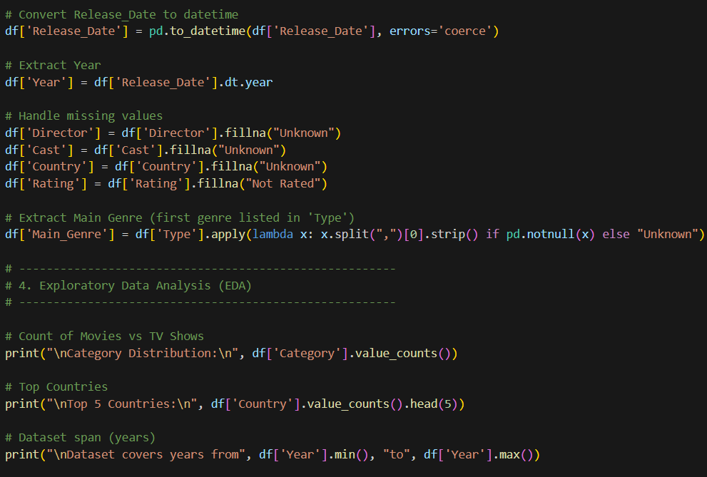
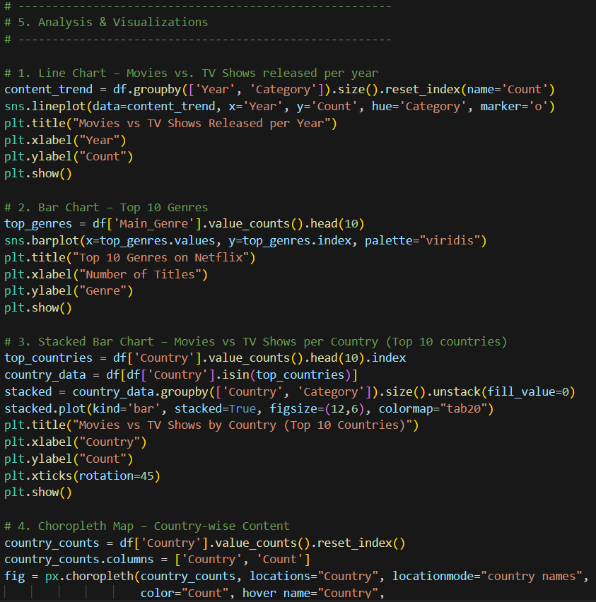
RESULTS :

Slide 7
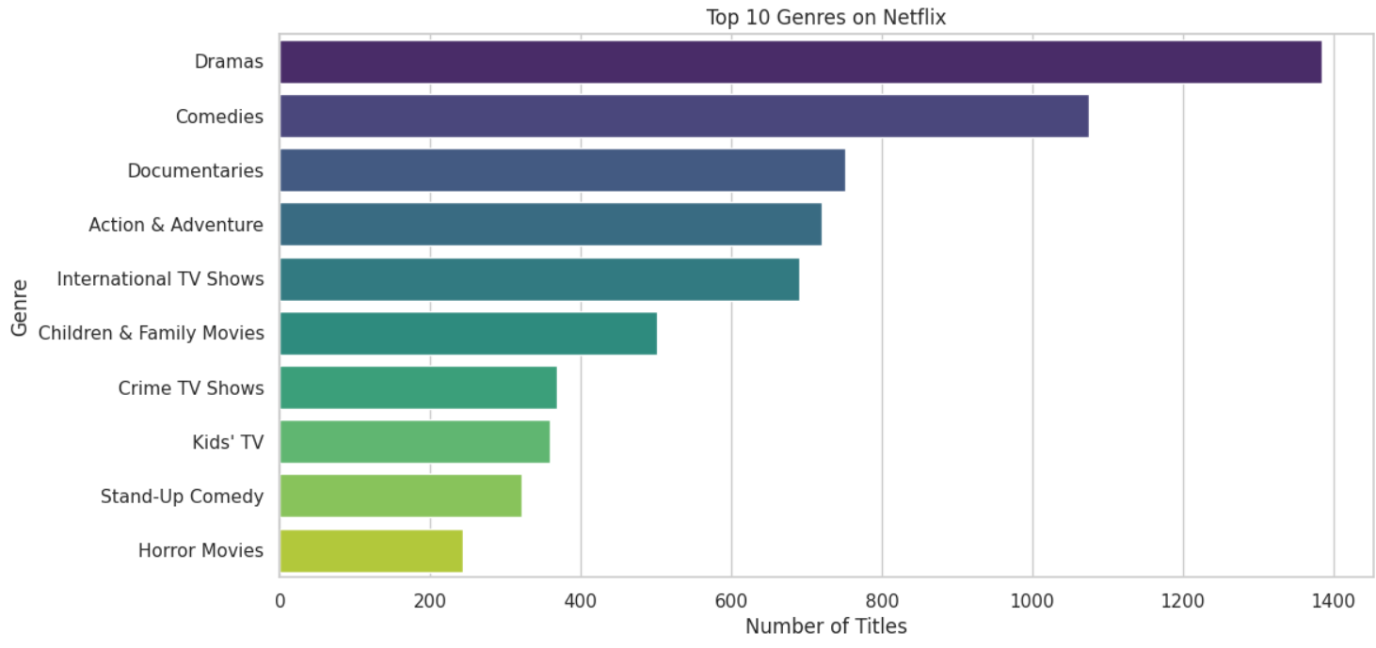
RESULTS :

Slide 8
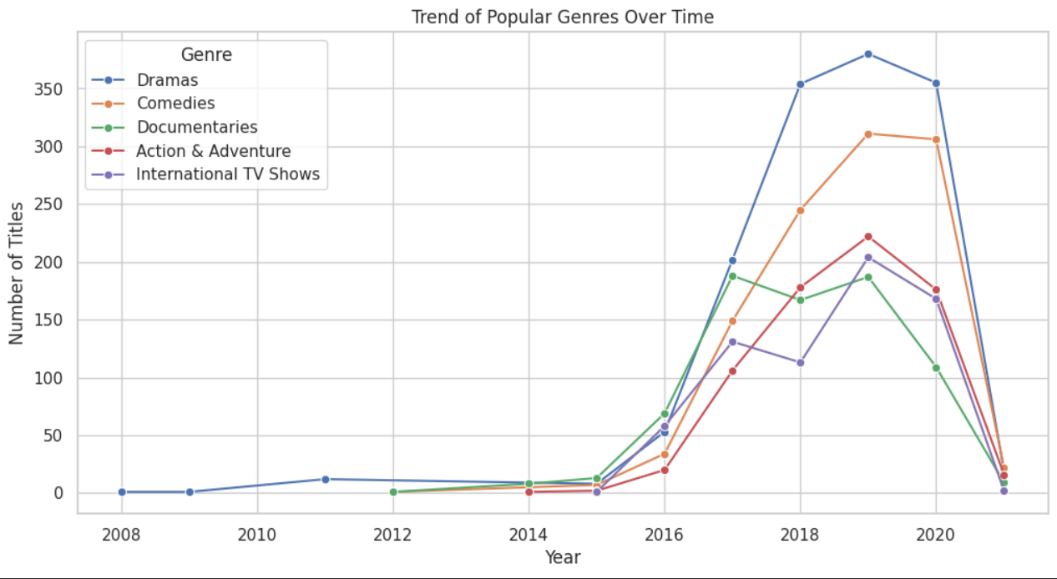
RESULTS :

Slide 9
GitHub repository
https://github.com/AryaNandini-Contributor/VOIS_AICTE_Oct2025_MajorProject_Arya-Nandini.git

Slide 10

Getting started with Basics of Python Certificate

Slide 11
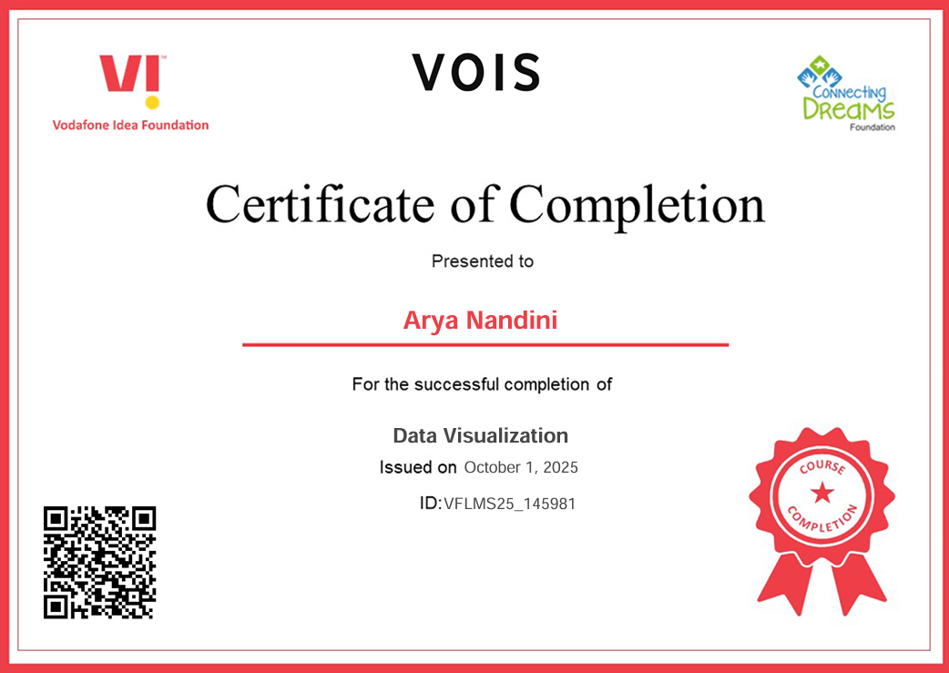
Data Visualization Certificate

Slide 12
Thank you
.
.

